Slide 1
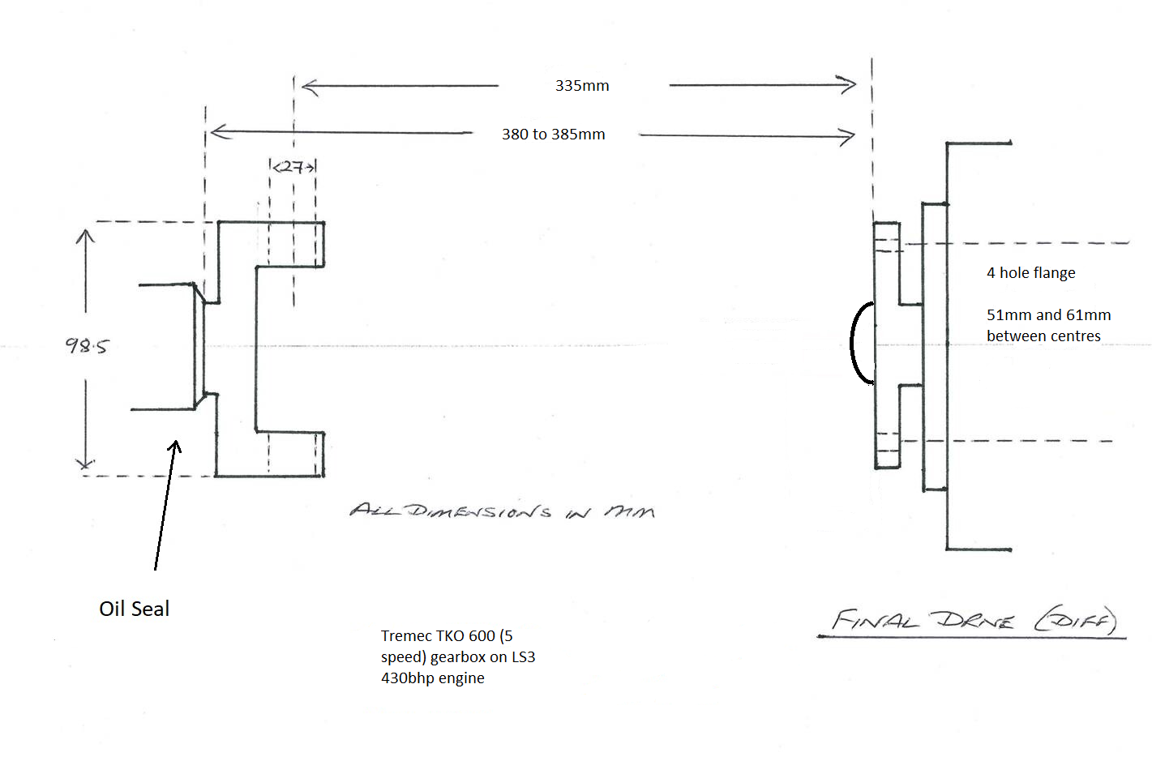
(make length 330mm) to give 5-10mm movement
43mm
61mm
Approx 80mm diagonal between holes
51mm
M10 holes in flange
8mm

